Slide 1
Database Final Project
Database For Hospital
NUID：001421068
Student：MINXUAN HU

Slide 2
01
Summary
02
Use Case
directory
03
ER Diagram
CONTENTS

Slide 3
Summary
01
Approach
Entity
Functionality

Slide 4

Summary
The project Hospital Healthcare Management System(HHMS) is for computerizing the working in a hospital, collection and storing data related to patients treatment, associated persons & accessories. The data stored in database with the ease of retrieval, update and analyze whenever needed. After tests, It generates test reports; provide prescription details including various tests, check-up and medicines prescribed to patient and doctor. It also provides injection details and billing facility. The system also provides the facility of backup as per the requirement. It needs everyday review and continuous amendments in the technology. Hence research & development is the core need and day to day improvements with amendment which is vital things for the healthcare database system.
“What
Makes us
Different
？”

Slide 5
entity
Tables : doctor, patient, staff, diagnosis, bill, test(include different tests databases),
prescription, medicine, injection, diet advice.
Patient Entity
Doctor
Staff
Diagnosis
Patient Id
Patient Name
Patient Tel
Patient Gender
Patient Age
Doctor Id
Doctor Name
Staff Id
Staff Name
Diagnosis Id
Blood Test _ Yes/No
X-ray Test _ Yes/No
Urine Test _ Yes/No
Gastroscopy Test _ Yes/No
Sonography Test _ Yes/No
Colonoscopy Test _ Yes/No
Final Diagnosis

Slide 6
entity
Tables : doctor, patient, staff, diagnosis, bill, test(include different tests databases),
prescription, medicine, injection, diet advice.
Injection Entity
Prescription
Diet Advice
Medicine
Injection Id
Injection Date
Injection Status
Prescription Id
Diet Advice Id
Diet Advice Content
Medicine Id
Medicine Name

Slide 7
entity
Tables : doctor, patient, staff, diagnosis, bill, test(include different tests databases),
prescription, medicine, injection, diet advice.
Bill
Blood Test
X-ray Test
Urine Test
Bill Id
Bill Date
Injection Fee
Test Fee
Diagnosis Fee
Total Amount
Id
Date
HIV
ESR
Others
Id
Date
X-Ray Name
Remark
Others
Id
Date
Sugar
Reaction
Others
Gastroscopy Test
Sonography Test
Colonoscopy Test
Id
Date
CORPUS
FUNDWS
Others
Id
Date
L _ Size
PV
Others
Id
Date
ECTUM
ANAL CANAL
Others

Slide 8
Functionality
Various operational works that are done in a Hospital are:
Recording information about the Patients that come.
Generating bills.
Recording information related to diagnosis given to Patients.
Keeping record of the Immunization provided to patients.
Keeping information about various diseases and medicines available to cure
The work is done as follows:
Information about Patients:
Patients name, age and gender. Whenever the Patient comes up his information is stored freshly.
Bills :
price for each facility provided to Patient on a separate sheet and at last they all are summed up.
Test includes several specific tests to produce the diagnosis for patients.
Immunization records are maintained in pre-formatted sheets, which are kept in a file.
Information about various diseases is not kept as any document.
Doctors themselves do this job by remembering various medicines.
Doctors have to remember various medicines available for diagnosis and sometimes miss better alternatives as they can’t remember them at that time.

Slide 9
System Operation Process
Patient: they go to hospital, and they have own patient information, then
Doctor: make prescriptions for patients, then
Prescription: arrange different test: include blood test, urine test, sonography test, colonoscopy test, x ray test, and gastroscopy test, causing test fee, and prescriptions also generate the diet advices and medicine and injection issue; then
Diagnosis: from these test results, and cause diagnosis fee, then
Bill: include all of fee : diagnosis fee, injection fee, test fee, medicine fee, then
Patient get the bill to check out and pay.

Slide 10
USE CASE
02

Slide 11
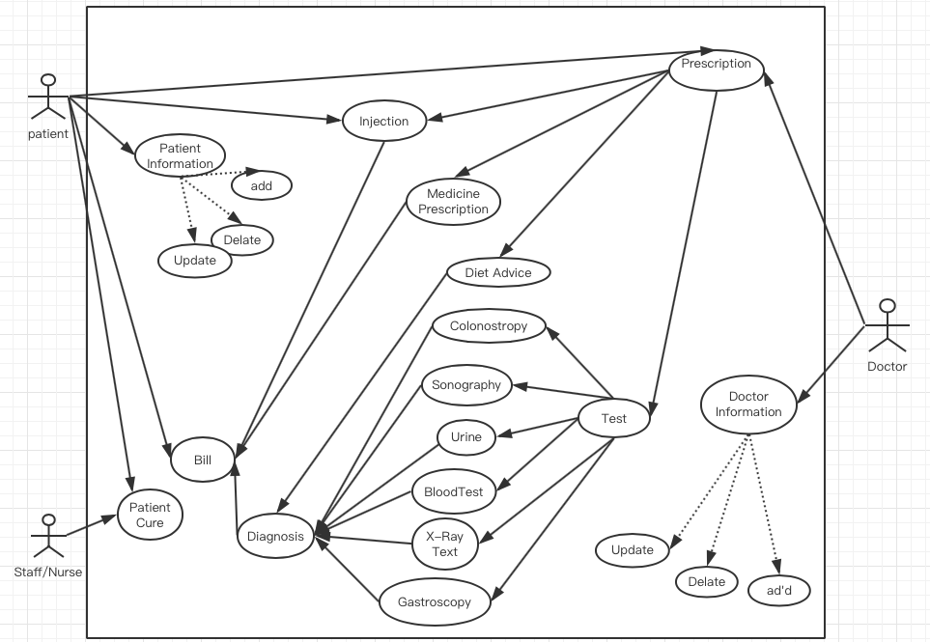
USE CASE Diagram

Slide 12
ER Diagram
03

Slide 13
ER Diagram

Slide 14
Thank ❤️ You

